Slide 1
Development of Analysis Techniques for Dynamic Magnetic Resonance Imaging of the Knee
Master Thesis Defense
Medical Photonics
Application to Tibiofemoral Kinematics
Jena | 25.10.2024 | Aayush Nepal | 198683 | Sumbitted on June 11, 2024

Slide 2
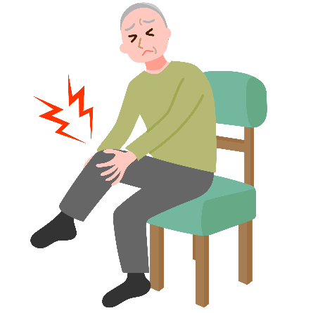
Motivation: Relevance of knee kinematics
Knee osteoarthritis (OA) affects 10% men and 13% of women aged 60 and older (Zhang et al., 2010)
Altered tibiofemoral kinematics in OA patients can potentially accelerate disease progression (Farrokhi et al., 2014)
Even in ACL-deficient knees without instability symptoms, knee kinematics are altered (Yang et al., 2018)
Understanding tibiofemoral kinematics is key to assessing knee joint function
Jena | 25.10.2024 | Aayush Nepal

Slide 3
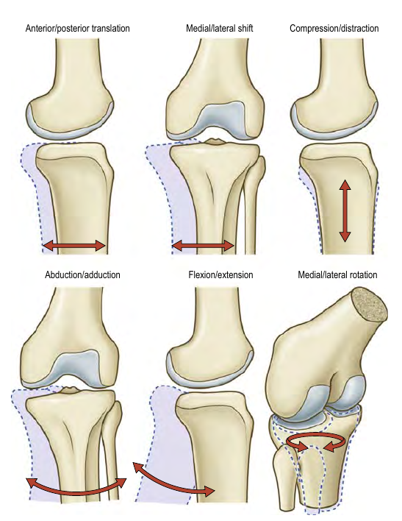
Tibiofemoral kinematics
Six Degrees of freedom
3 Rotations
Flexion-Extension
Medial-Lateral
Abduction-Adduction
3 Translations
Anterior-Posterior
Meidal-Lateral
Compression-Distraction
(Credit: Gray’s Anatomy 42nd ed.)
Jena | 25.10.2024 | Aayush Nepal
Notes:
If we can quantify any one of these motions accurately, then vital information might be revealed.

Slide 4
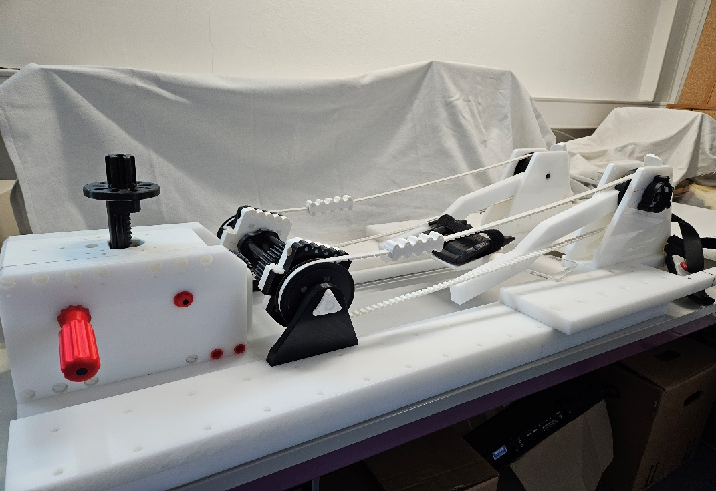
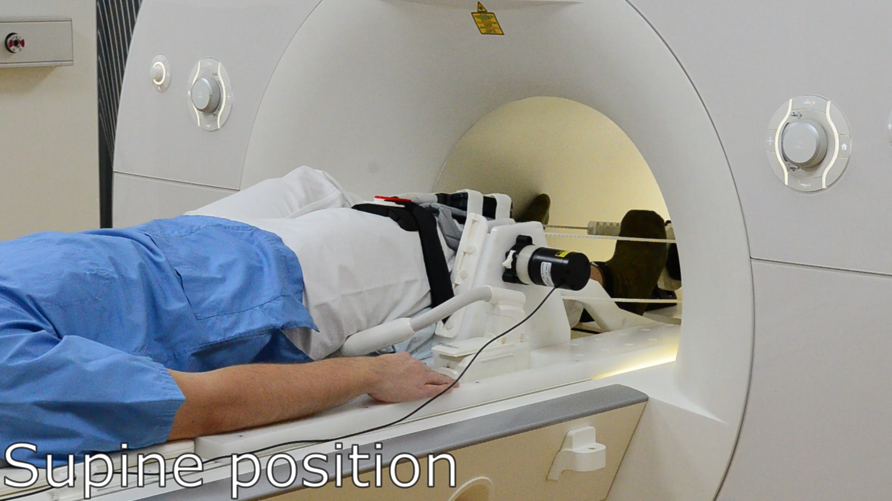

The Setup
Jena | 25.10.2024 | Aayush Nepal
Notes:
This device was developed (a few years ago) in collaboration with our partners at Charite Berlin

Slide 5
Knee flexion-extension device
Repeated active open-chain knee flexion-extension exercise
5 volunteers
Guided by the beat of a metronome at 60 bpm
Once without additional weight and once with 12 kgs
Each scan lasted a duration of 160 seconds
Range of motion achieved within the scanner ~(30-46)°
Jena | 25.10.2024 | Aayush Nepal
Notes:
This device was developed (a few years ago) in collaboration with our partners at Charite Berlin

Slide 6
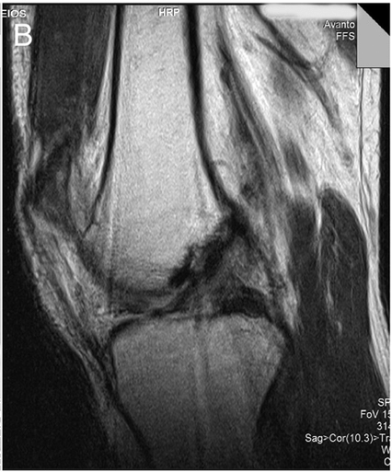
Imaging sequence and acquisition
Imaging the moving knee: Not your typical MRI setup.
Generally, we want to avoid movement inside the scanner.
A few different things allow us to overcome this challenge:
Lavdas 2012, doi:10.1016/j.mri.2012.04.001
Jena | 25.10.2024 | Aayush Nepal

Slide 7
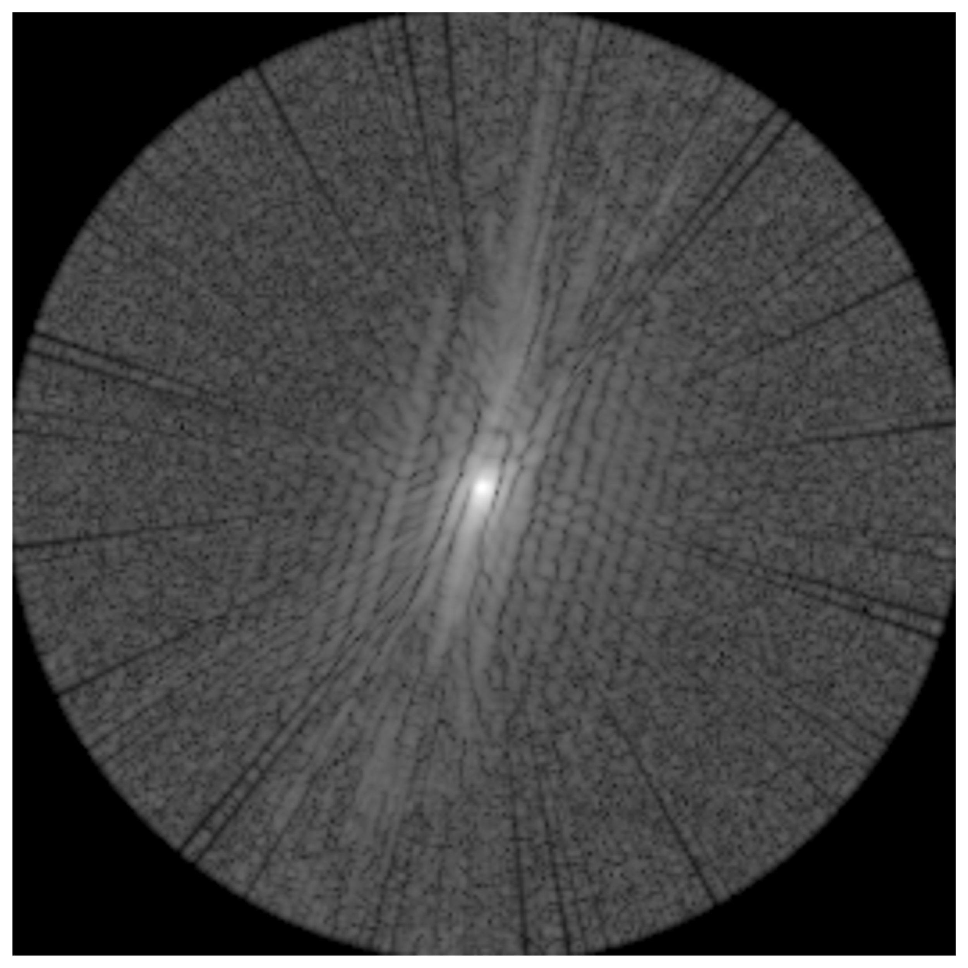
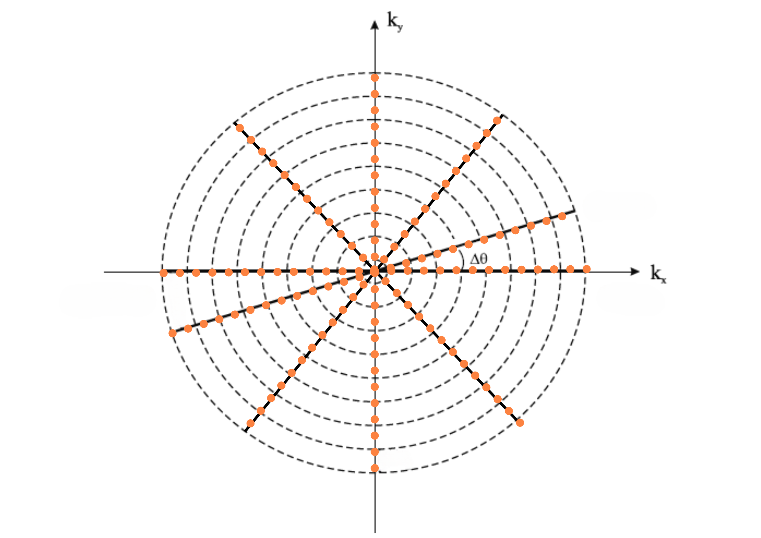
Imaging sequence and acquisition
Imaging the moving knee: Not your typical MRI setup.
Generally, we want to avoid movement inside the scanner.
A few different things allow us to overcome this challenge:
Non-cartesian sampling of k-space: Radial Golden-Angle
Speed!: Gradient Echo FLASH: Small flip angle allows for shorter repetition times
Syncing and CINE:
Each k-space contains data across a range of flexion angles
Optical fibre position sensor samples the knee flexion precisely (0.0025°)
Scanner data is synchronized with optical sensor data using trigger signals
K-space data is sorted into 2-degree knee angle intervals
A ‚cinema‘ or ‚movie‘ of the knee motion is created
Jena | 25.10.2024 | Aayush Nepal

Slide 8
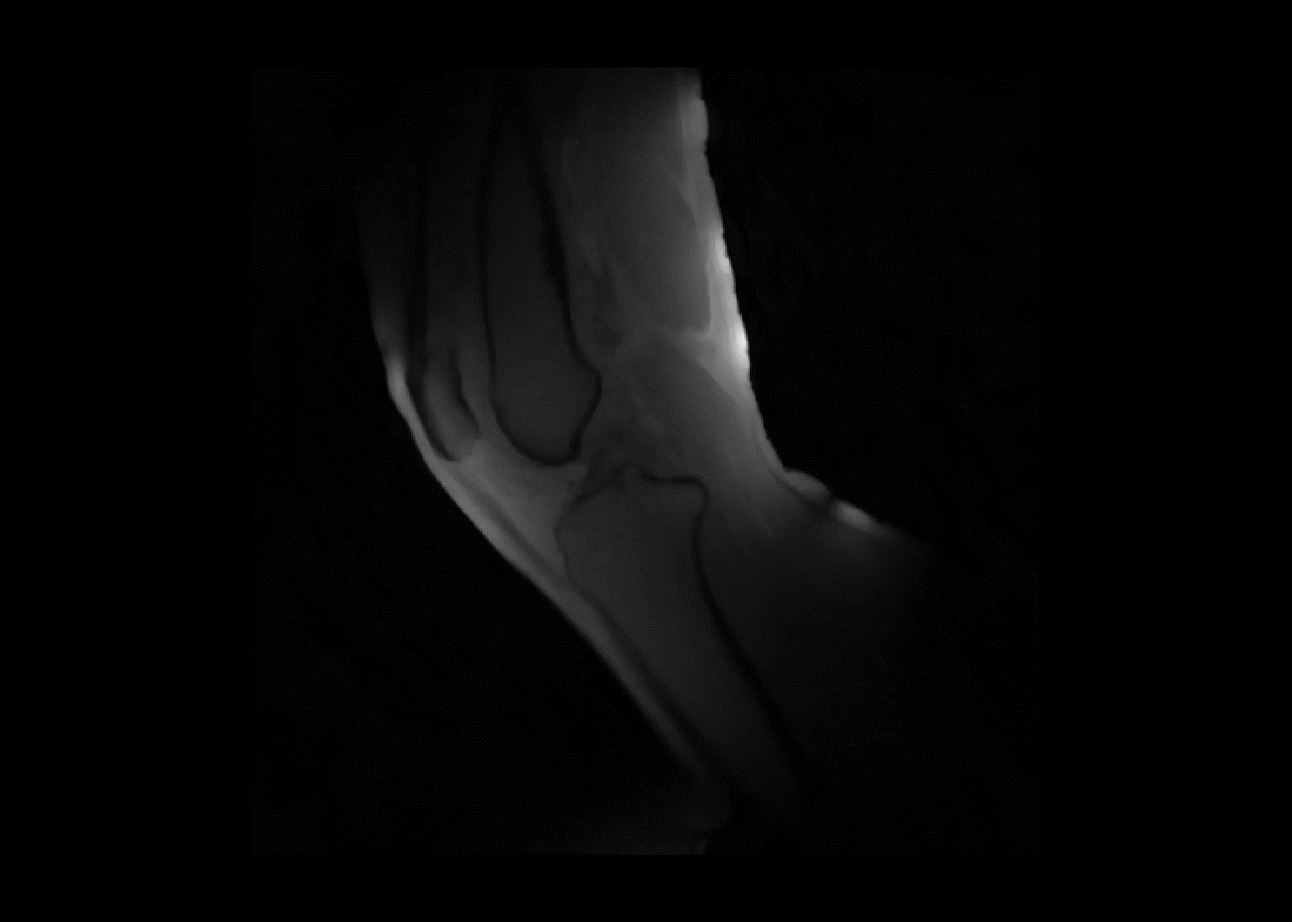
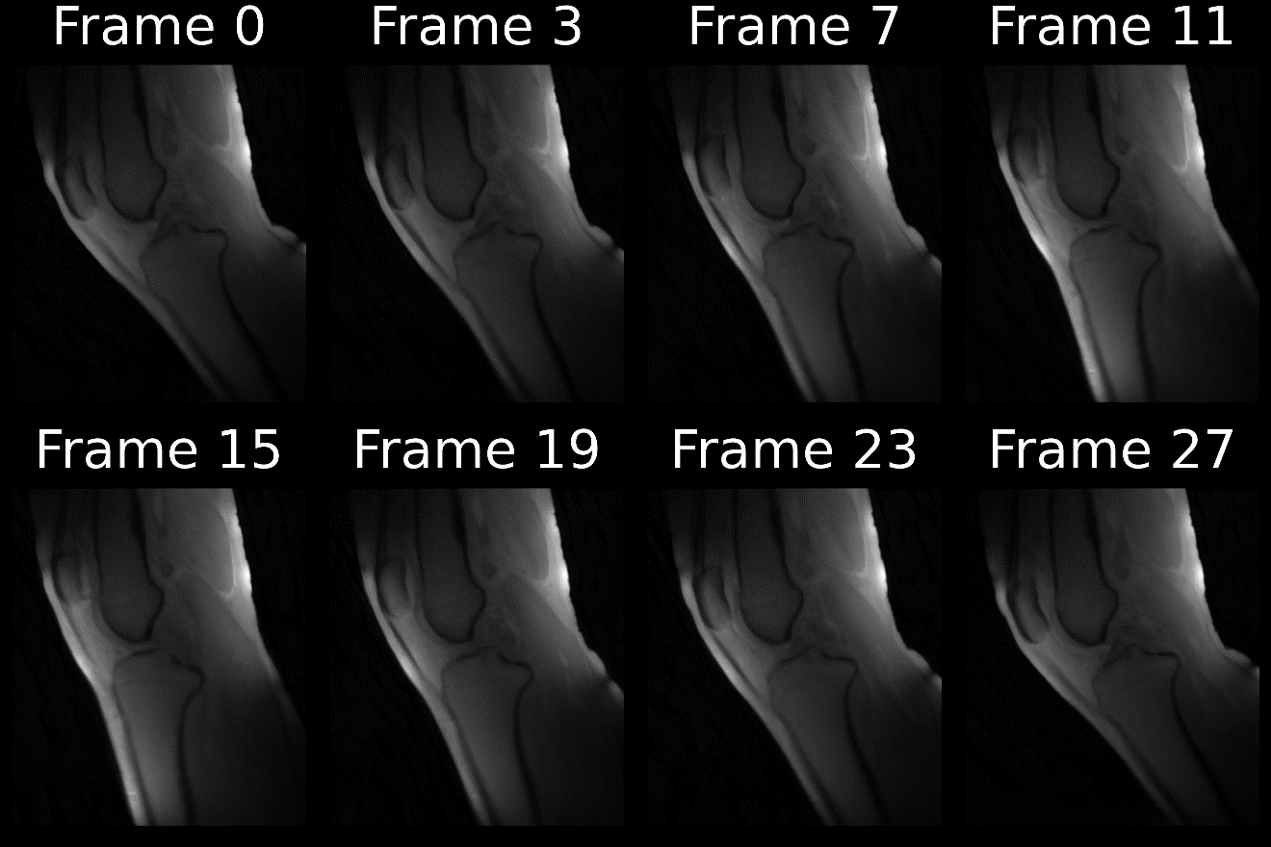
Reconstructed frames

Slide 9
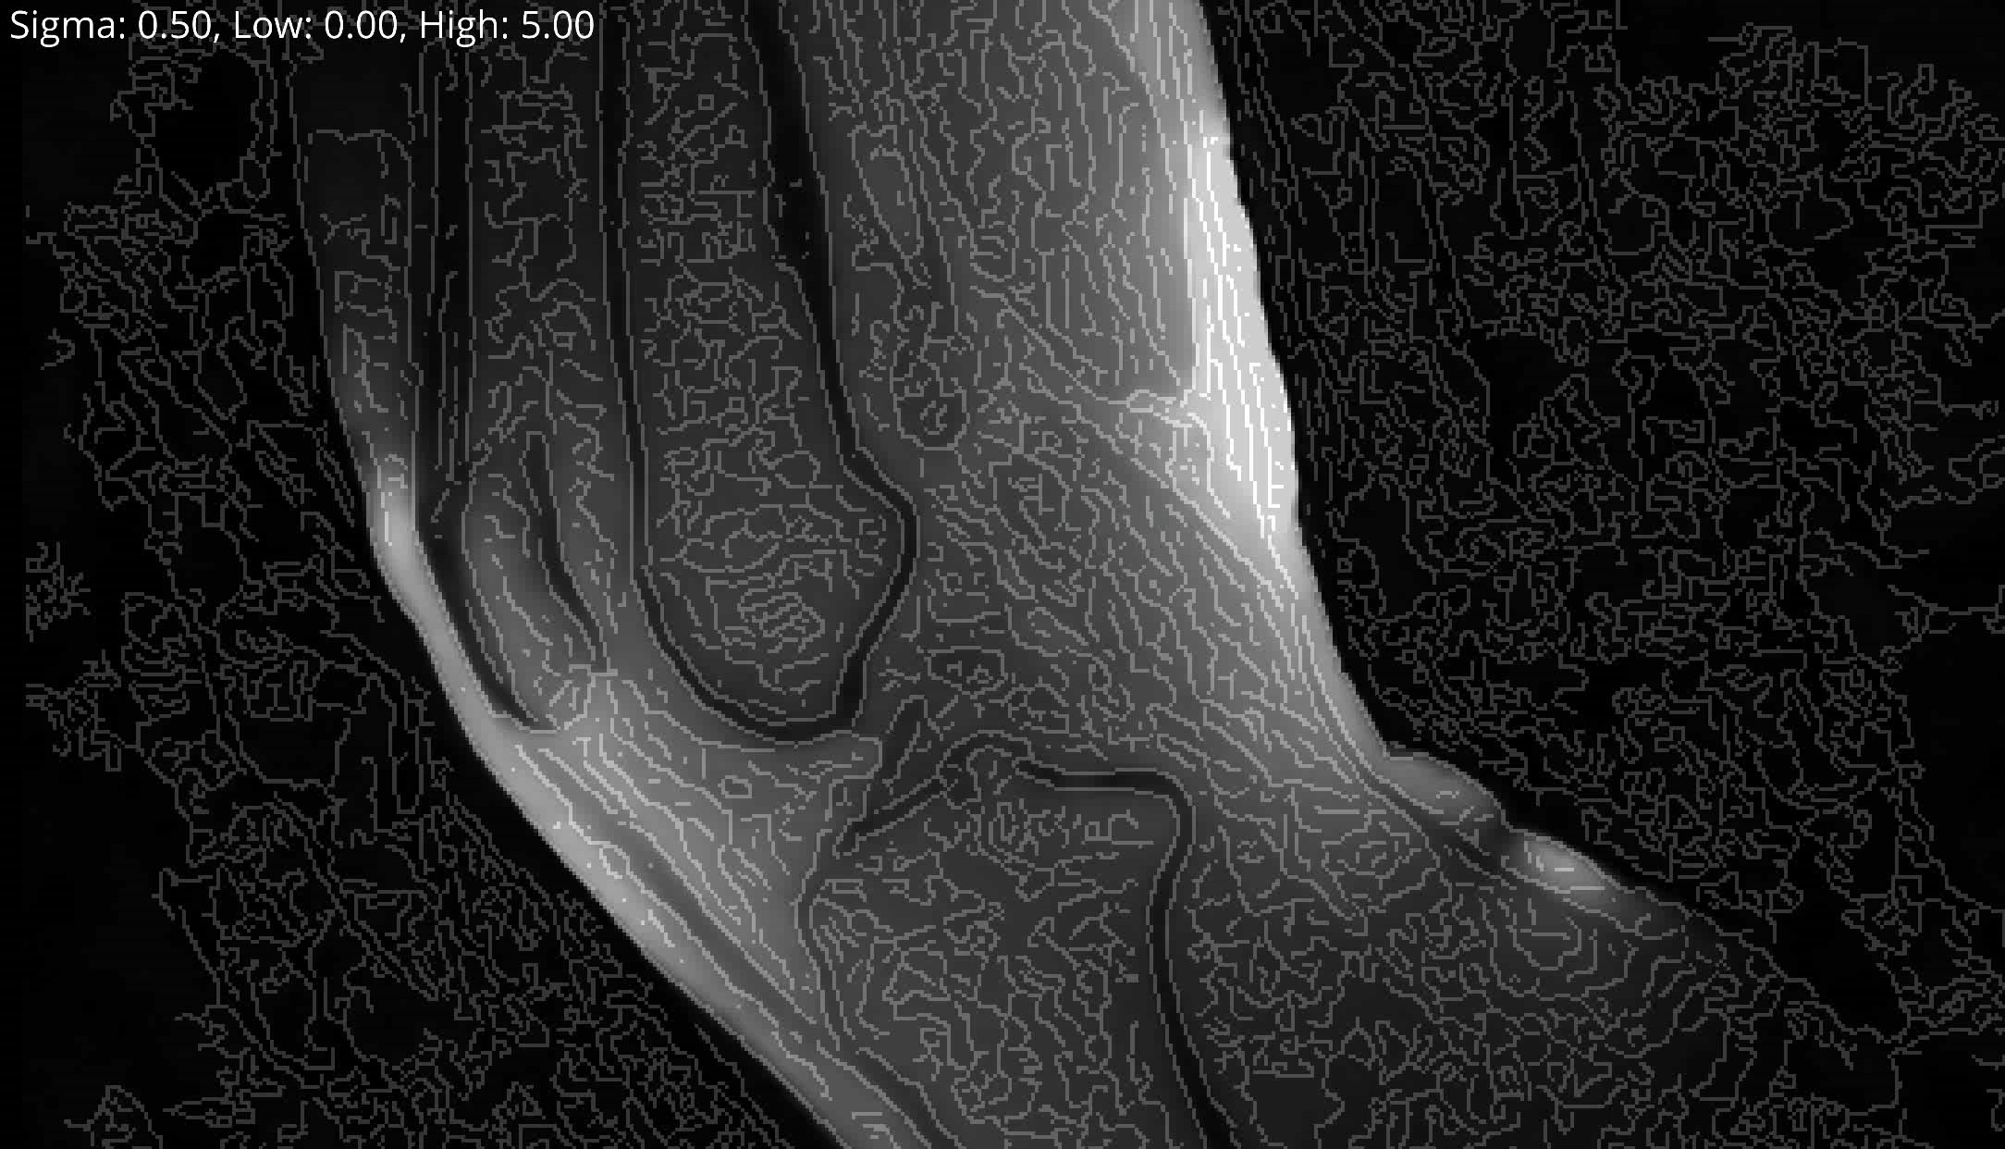
Methods: Edge Detection
Hystereses Thresholding (Pixels and their gradient magnitude)
Strength of gaussian blur
Low Threshold: lower values are discarded (not an edge)
High Threshold: values higher are ‘Strong Edges’
In Between: ‘Weak Edges’ Only kept if connected to a strong edge

Slide 10
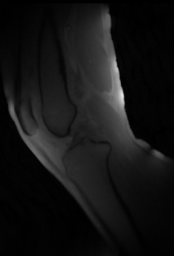
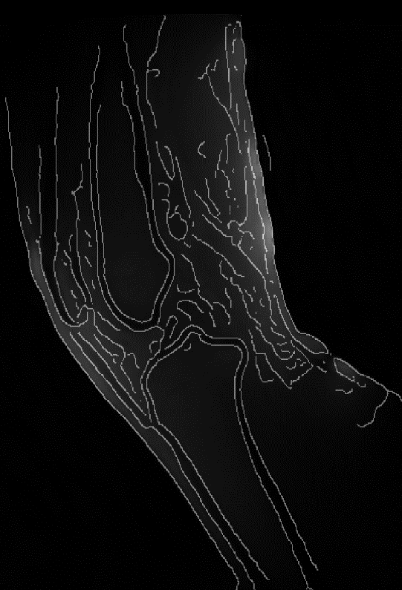
Methods: Edge Detection
Jena | 25.10.2024 | Aayush Nepal

Slide 11
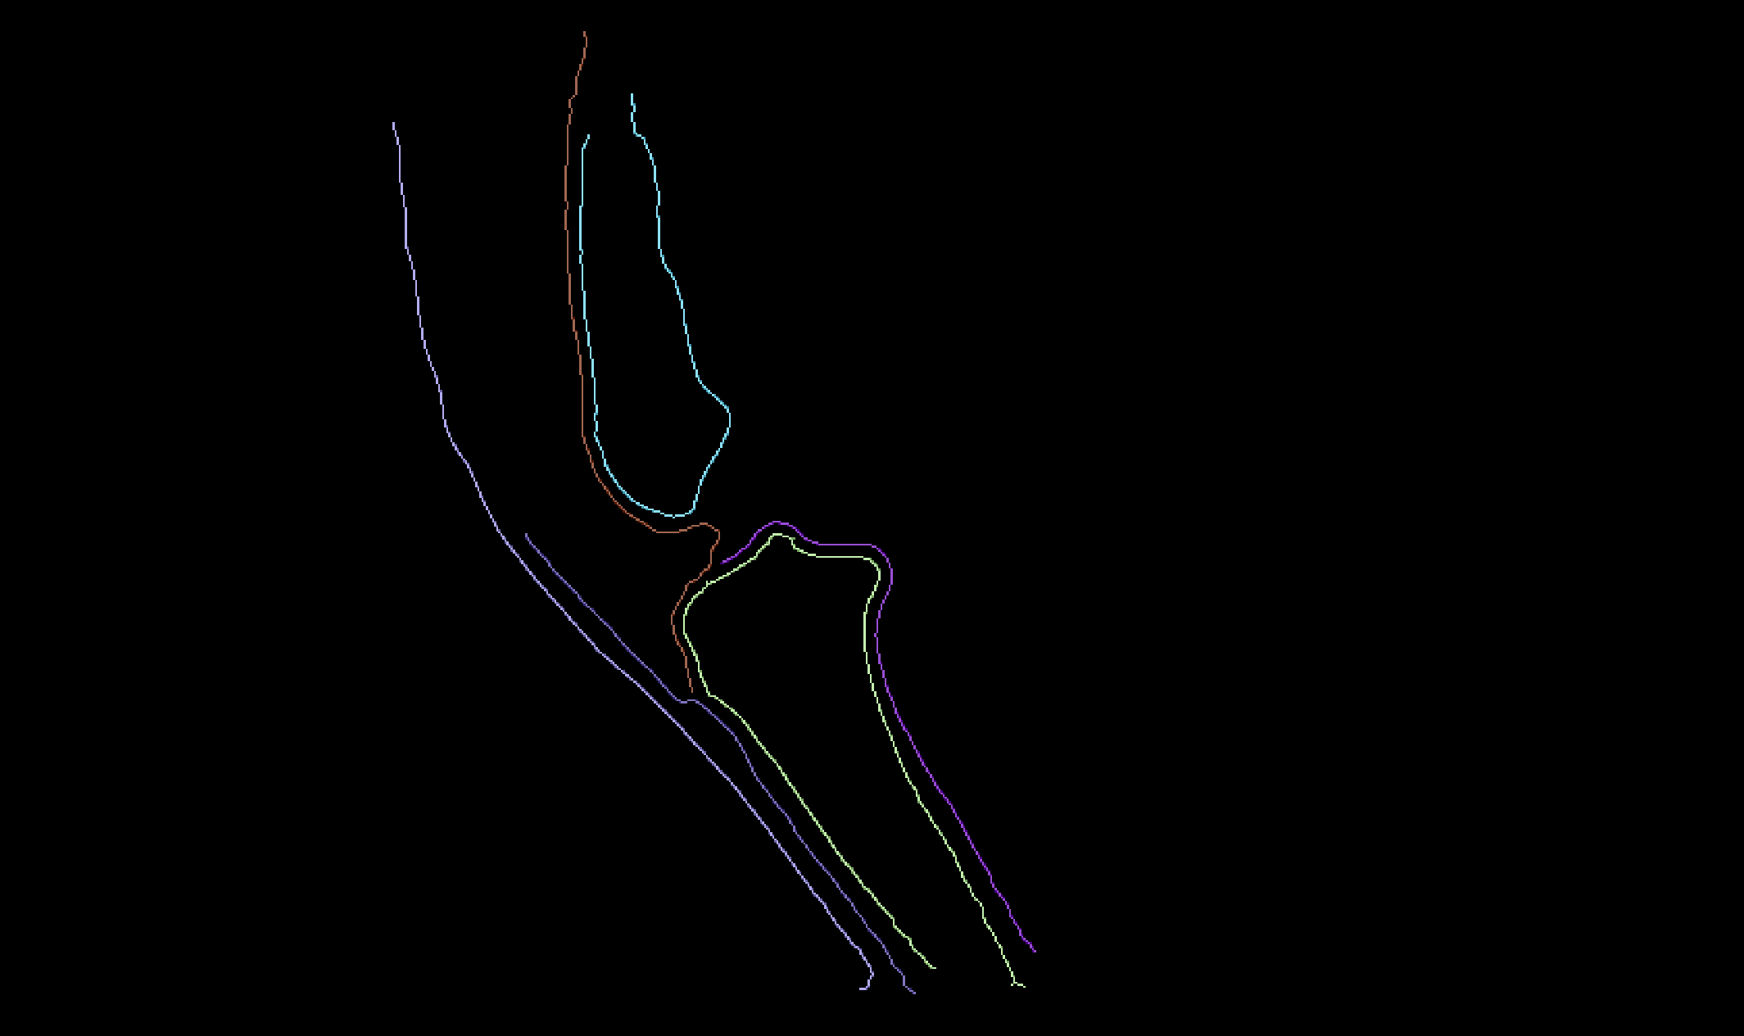
Methods: Connected Component Labelling
Treated the series of 2d arrays as a 3d volume.
3 × 3 × 3 structuring element
26-way connectivity
+
Skeletonization
+
Jena | 25.10.2024 | Aayush Nepal
Remove small objects

Slide 12
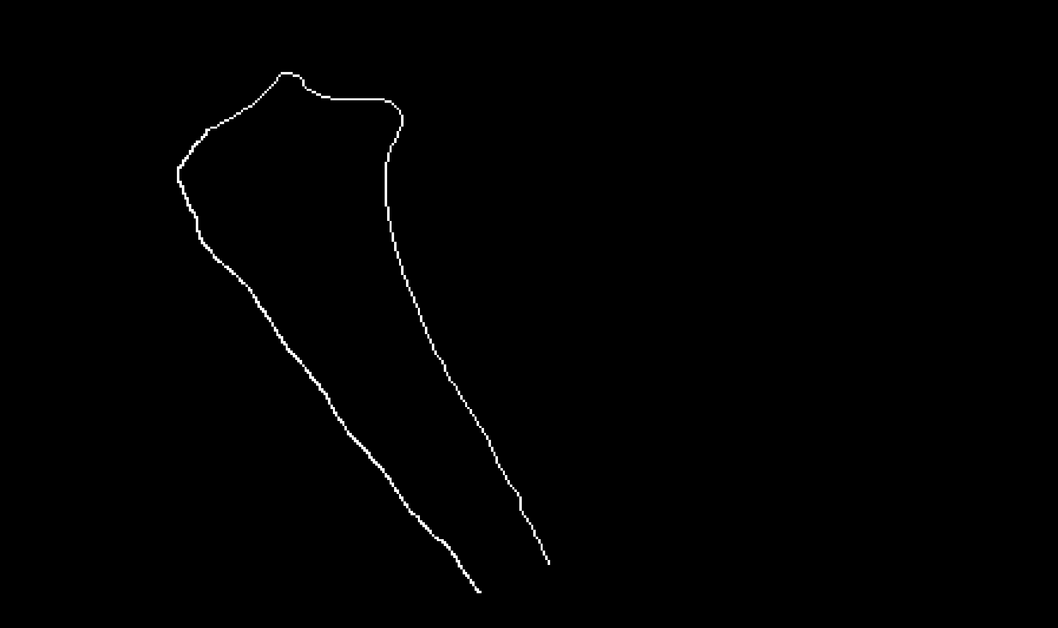
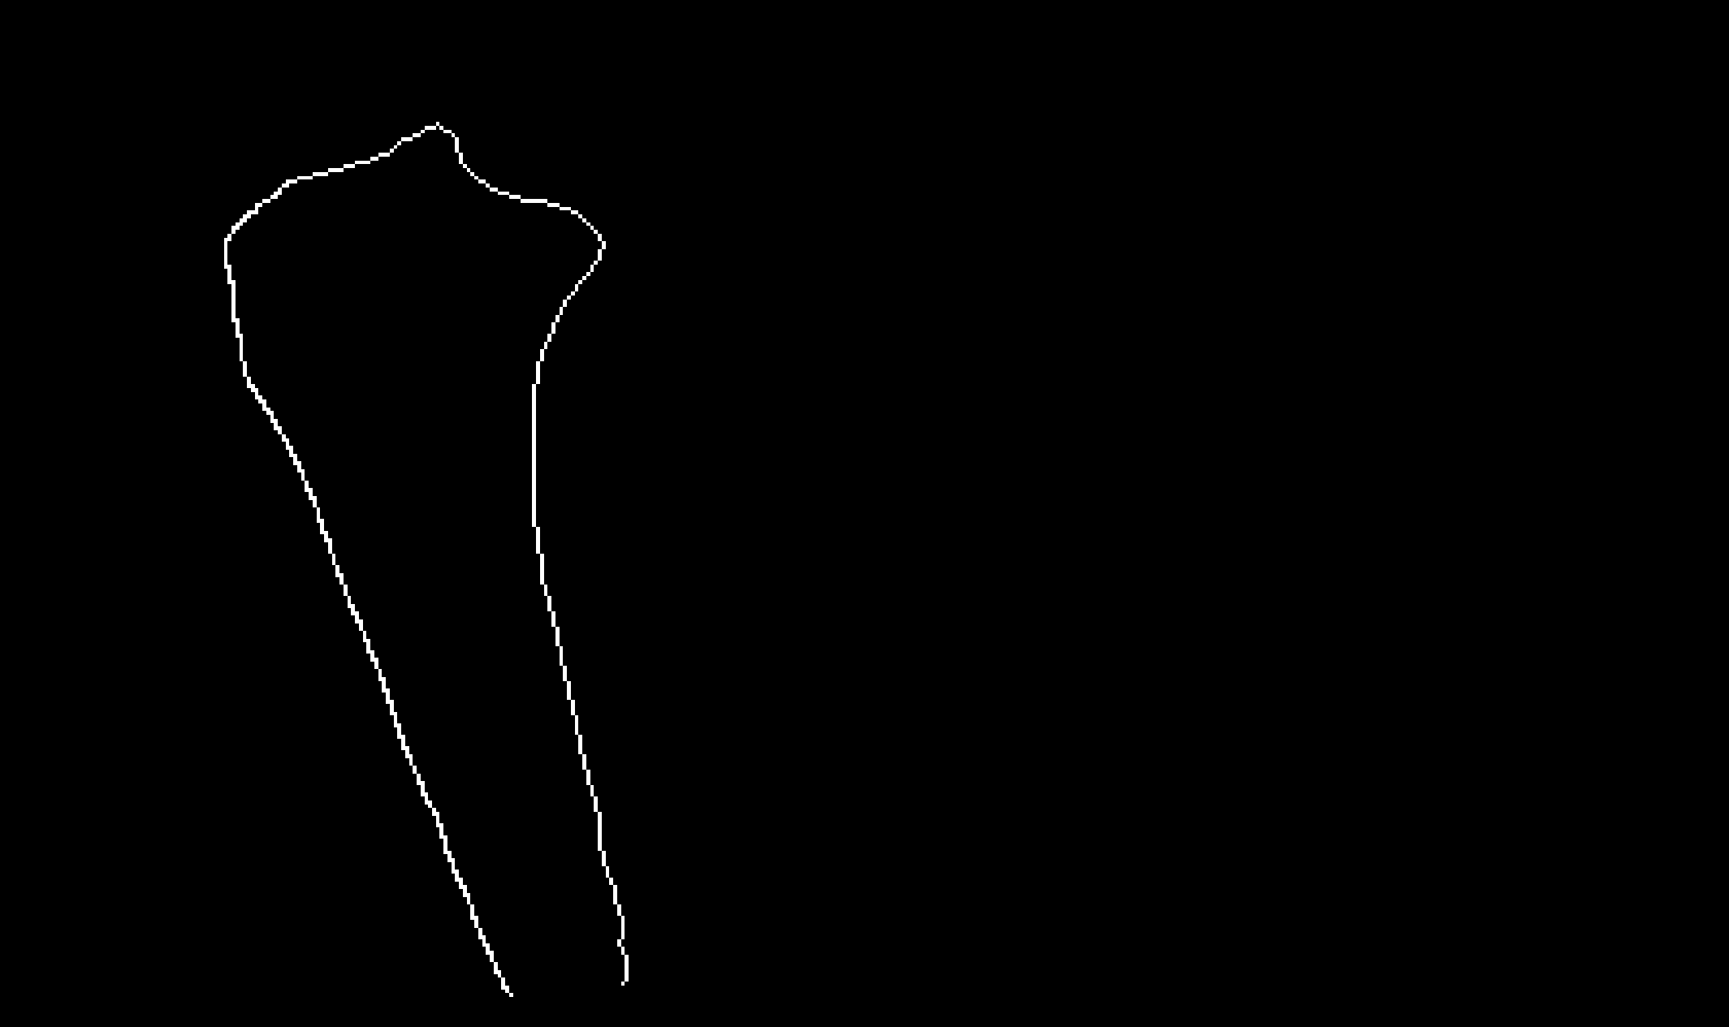
Methods: Example sets
SET R
SET Q
?
Jena | 25.10.2024 | Aayush Nepal

Slide 13
Methods: Issues with raw coordinates
SET R
SET Q
Inefficient computation
?
Lack of correspondance
Order matters
Inconsistent sampling
Uneven number of points
Jena | 25.10.2024 | Aayush Nepal

Slide 14
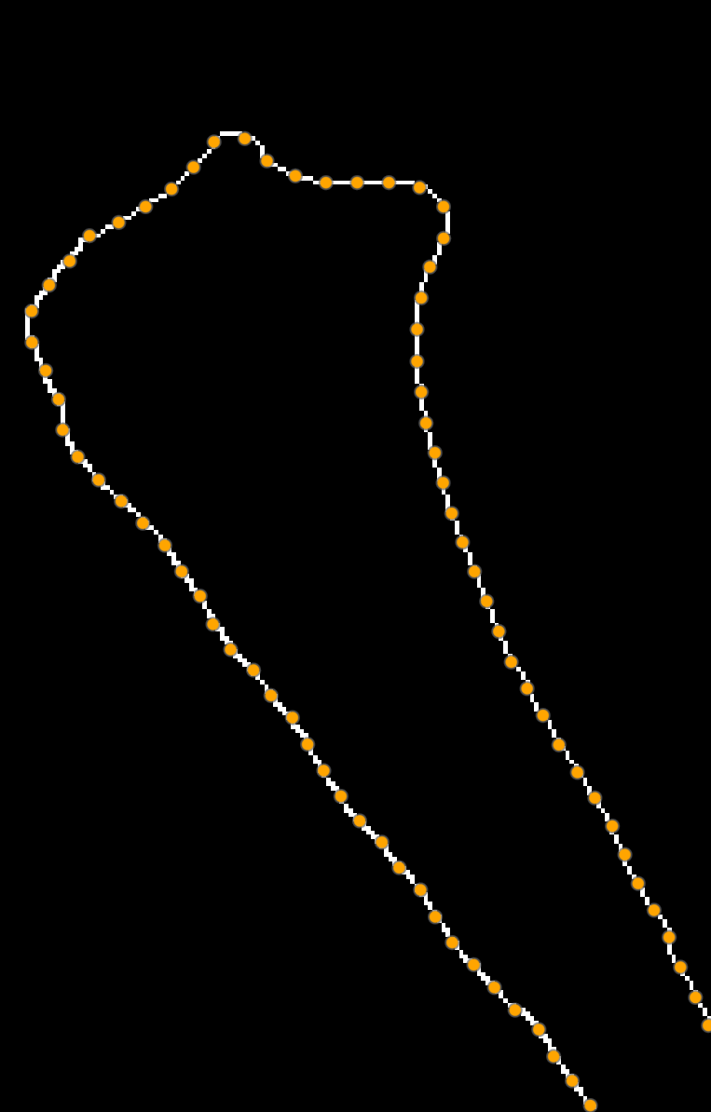
Methods: Sorting and Downsampling
SET R SET P
Sorting:
most distal and posterior point for the tibia, most proximal for the femur
nearest neighbor approach to create an ordered path
2. Cubic Spline Interpolation:
create a smooth, continuous curve that passes through all points in ordered set R
parameterize the curve using arc length
3. Downsampling and point placement
Equal interval = total arc length of spline / desired number of points
place points along the spline at these equal arc length intervals
Jena | 25.10.2024 | Aayush Nepal

Slide 15
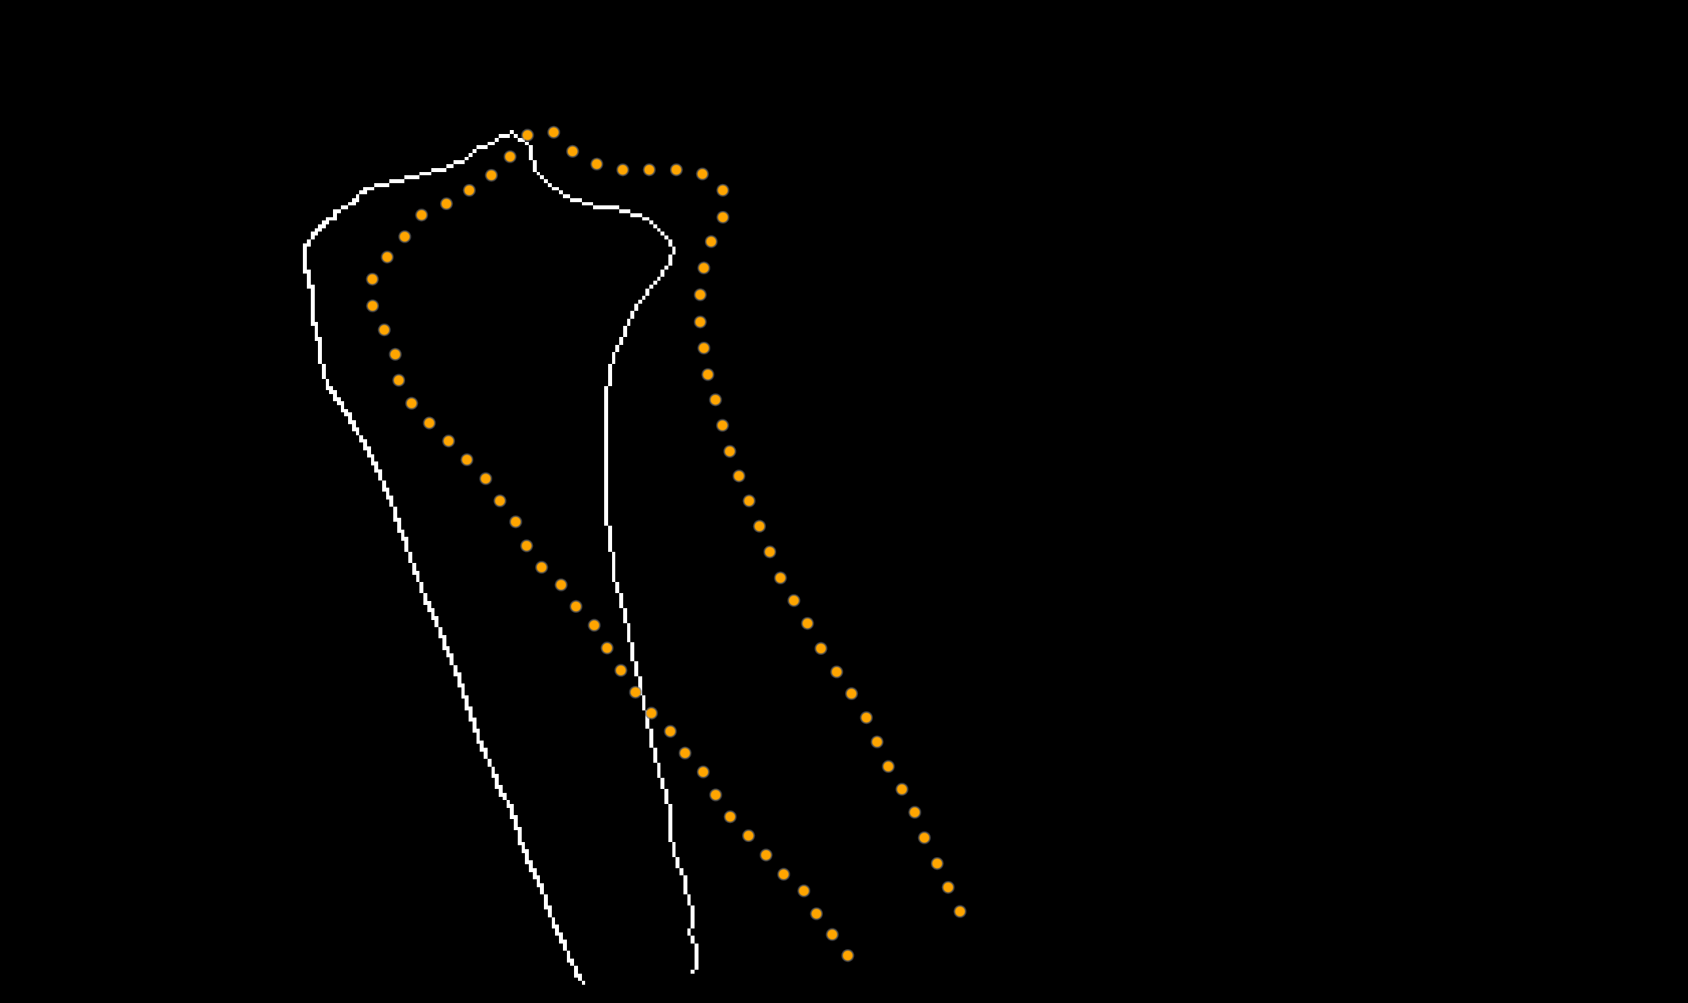
Methods: Alignment of Set P to Q
SET P
SET Q
?
Jena | 25.10.2024 | Aayush Nepal

Slide 16


Methods: Rigid Transformation for Edge Tracking
A point in set P (x,y) undergoes the following transformation:
$$\left[\begin{matrix}x′ \\ y′\end{matrix}\right]=R\left(φ\right)\left[\begin{matrix}x \\ y\end{matrix}\right]+\left\lceil \begin{matrix}Δx \\ Δy\end{matrix}\right\rceil$$
where, R(ϕ) is the 2D rotation matrix: $\left[\begin{matrix}\cos{φ} & −sin{φ} \\ \sin{φ} & \cos{φ}\end{matrix}\right]$
And (Δx,Δy) are the translations in the sagittal plane.
Optimize for: (Δx,Δy, $φ$)
2. A cost function that quantifies the misalignment between each ($x′$, y$′$) and its nearest neighbour in set Q.
$$C\left(Δx, Δy, φ\right)= \sum_{p=1}^{N}{\min_{qεQ}\left(\sqrt{{\left(x_{q}−{x′}_{p}\right)}^{2}+{\left(y_{q}−{y′}_{p}\right)}^{2}}\right)}$$
Set P
Set Q
Jena | 25.10.2024 | Aayush Nepal

Slide 17
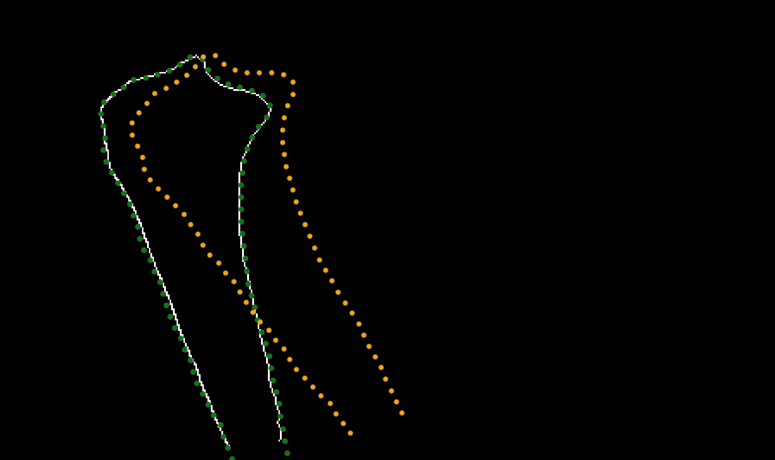
Methods: Rigid Transformation for Edge Tracking
Frame-by-frame transformation. Each transformed frame is used as reference for the next.
Nelder-Mead simplex algorithm („fmin search“)
Parameters:
Initial guess: [0,0,0]
Maximum iterations: 1000
Function tolerance and parameter tolerance: 1e-8
Once the set of parameters are obtained, any shape drawn on one frame on the bone will automatically be transformed to the rest of the frames
Set P
Set P‘
Set Q
Jena | 25.10.2024 | Aayush Nepal

Slide 18
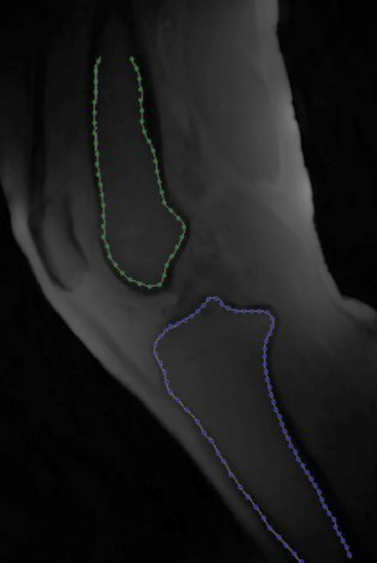
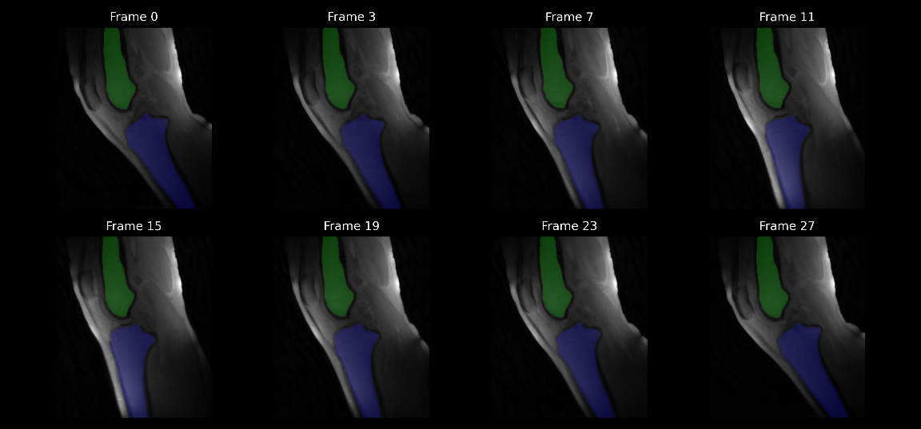
Methods: Applying transformation
Jena | 25.10.2024 | Aayush Nepal

Slide 19
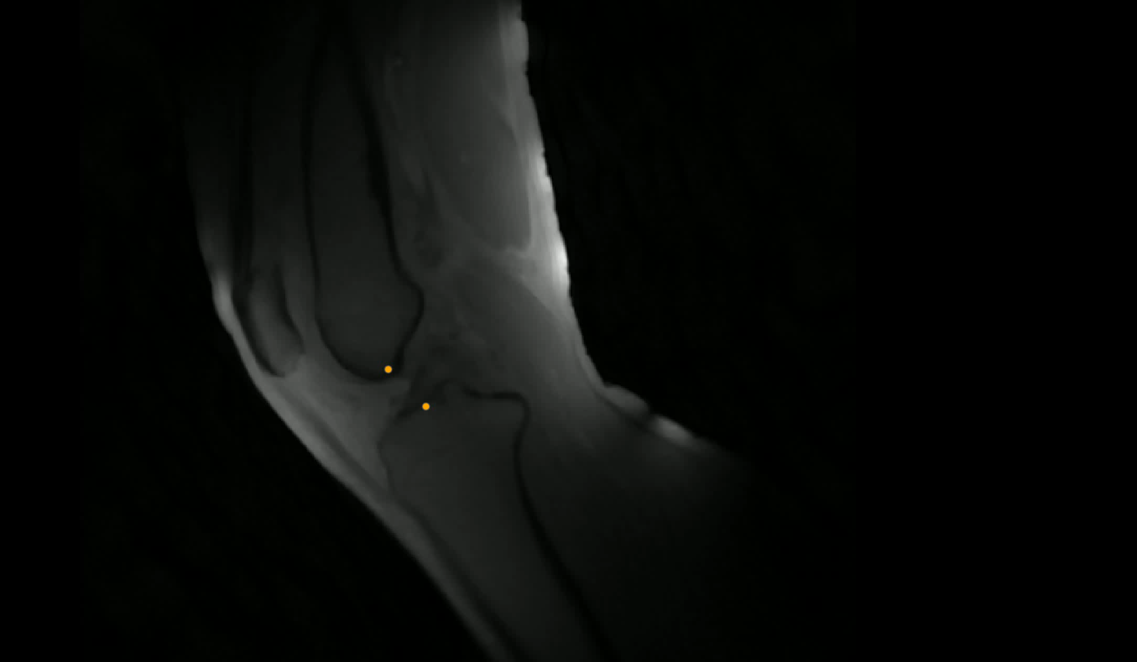
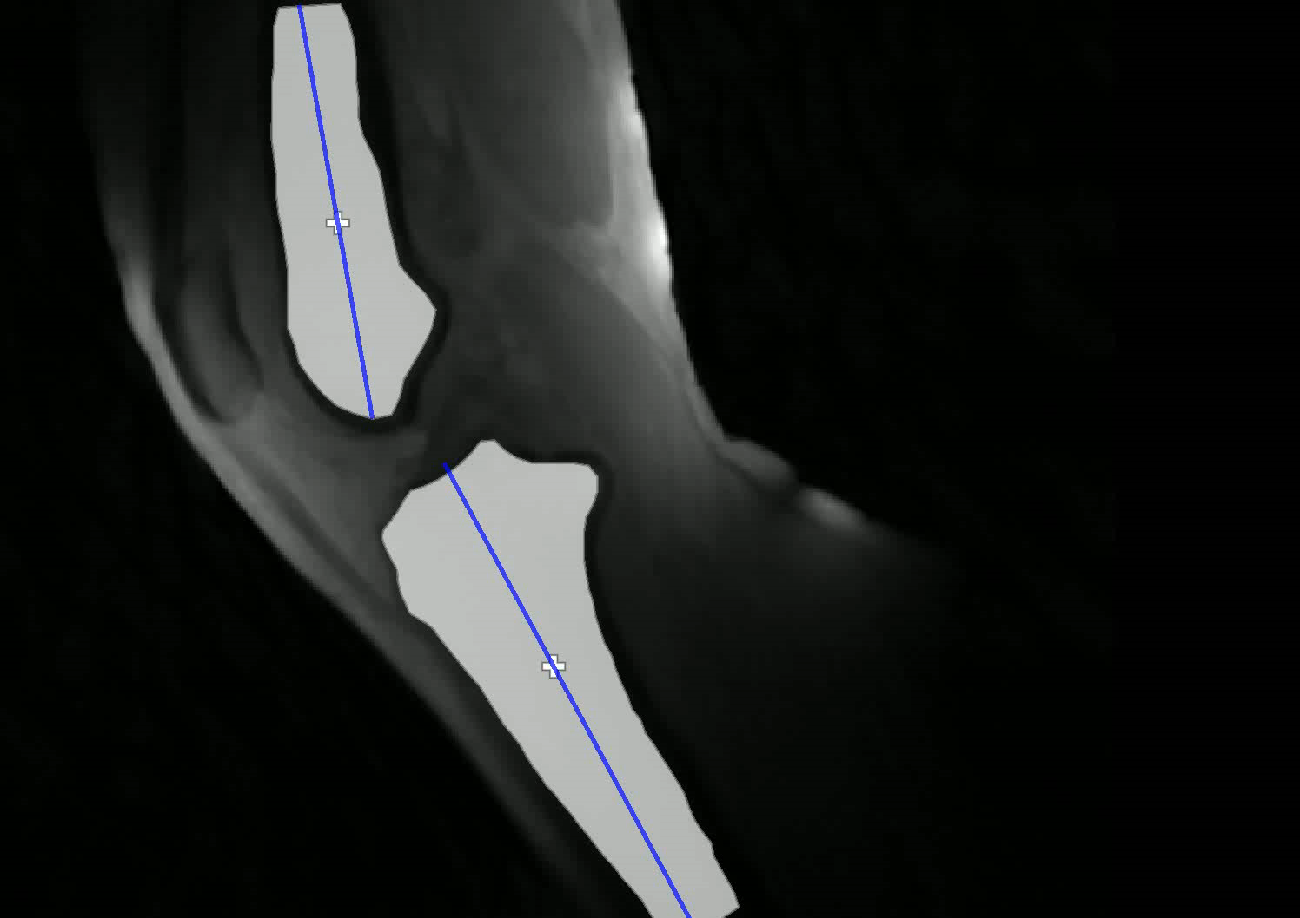
Parameter extraction and tracking
Distance measurement
Angle measurement
Jena | 25.10.2024 | Aayush Nepal

Slide 20
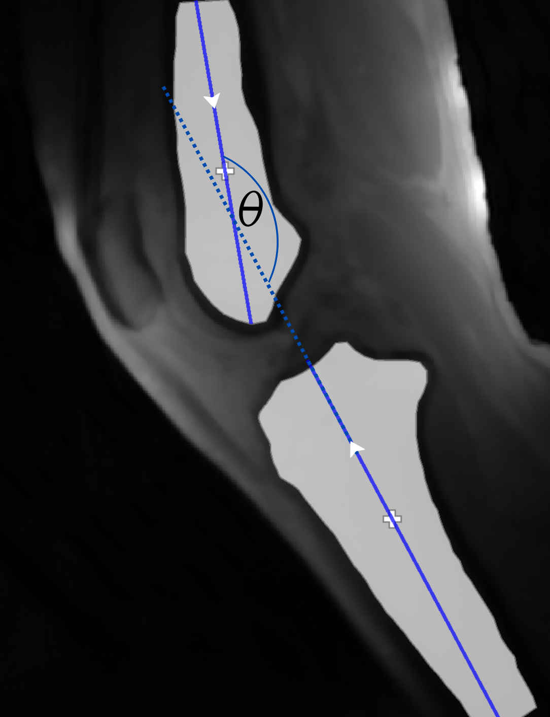
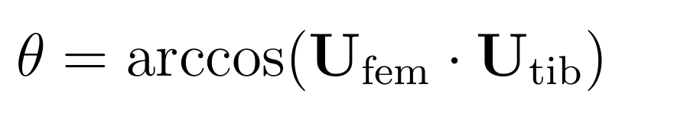
Calculations
Principle Component Analysis (PCA) was used to estimate the long axis of the bone segments.
- PCA identifies the direction of max. Variance
Simple euclidean distance formula was used for distance between the points
The time-axis had to be normalized due to varying ranges of motion of the subject‘s knee flexion angles.
Jena | 25.10.2024 | Aayush Nepal

Slide 21
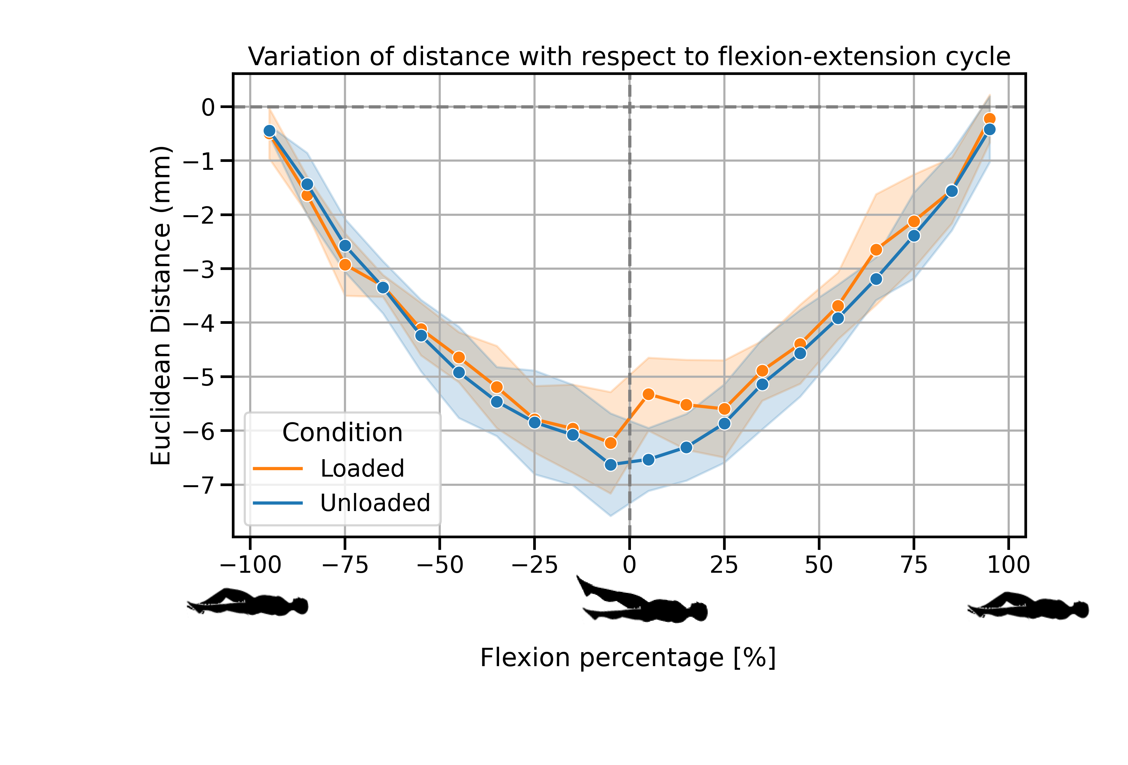
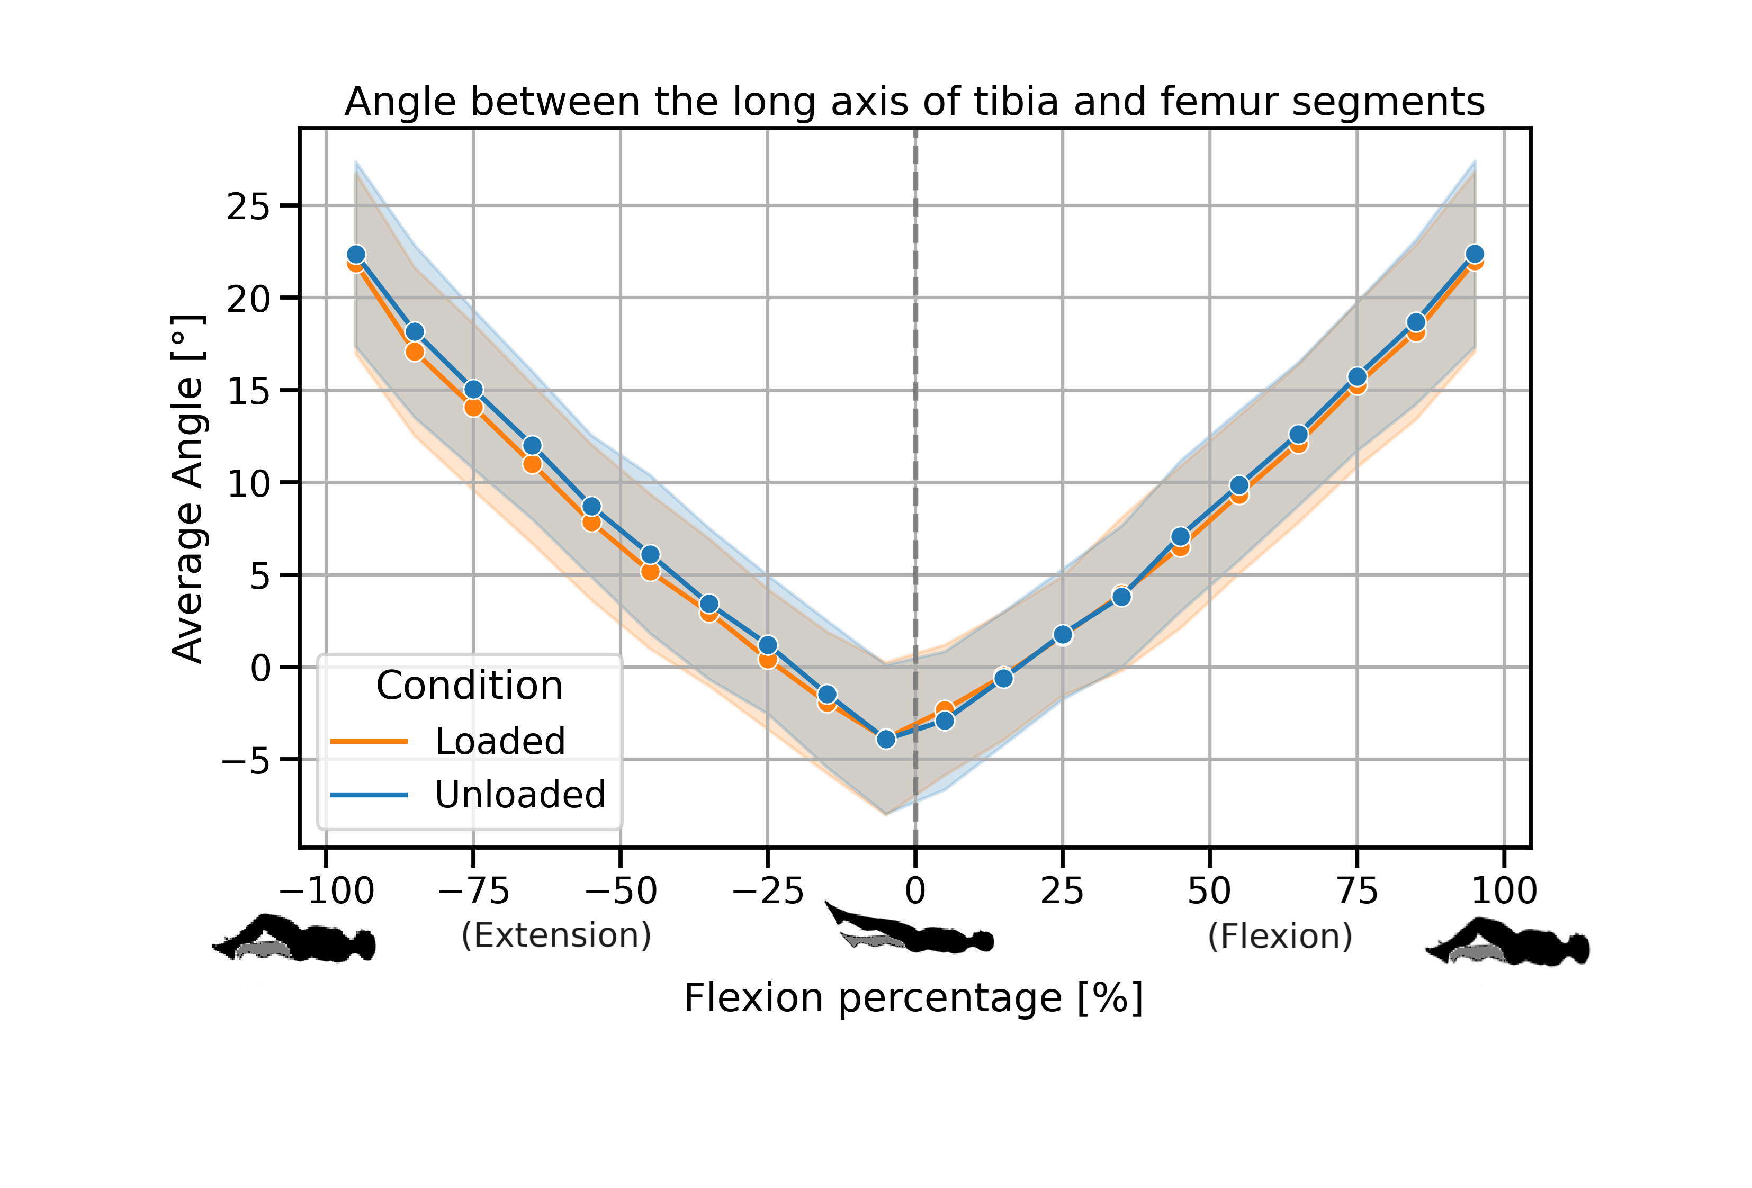
Results
Jena | 25.10.2024 | Aayush Nepal

Slide 22
Conclusion and Outlook
No significant differences were found in the angle measurements between loaded and unloaded measurements
There was a significant differnce (P<0.016) in the flexion percentage range of 0-25%
Normative trends can be established with more healthy volunteers
Same volunteers should be re-measured to assess self-consistency
Patella can be tracked in a similar manner to extract patellofemoral kinematics too
A multi-slice approach could be adapted for 3d datasets for a more comprehensive 3d kinematic analysis
Jena | 25.10.2024 | Aayush Nepal

Slide 23

Thank you for your attention!
Jena | 25.10.2024 | Aayush Nepal

Slide 24
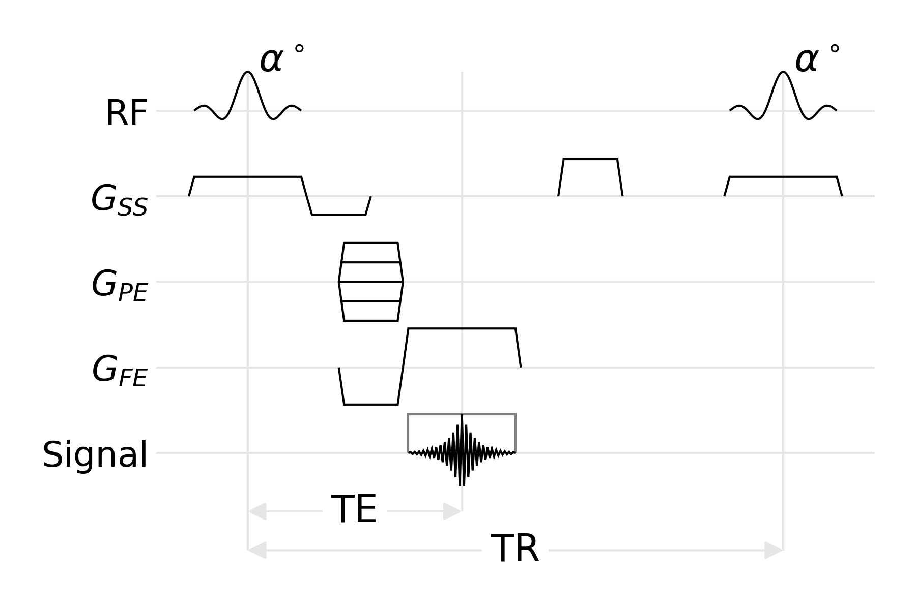
Supplementary materials
Jena | 25.10.2024 | Aayush Nepal

Slide 25
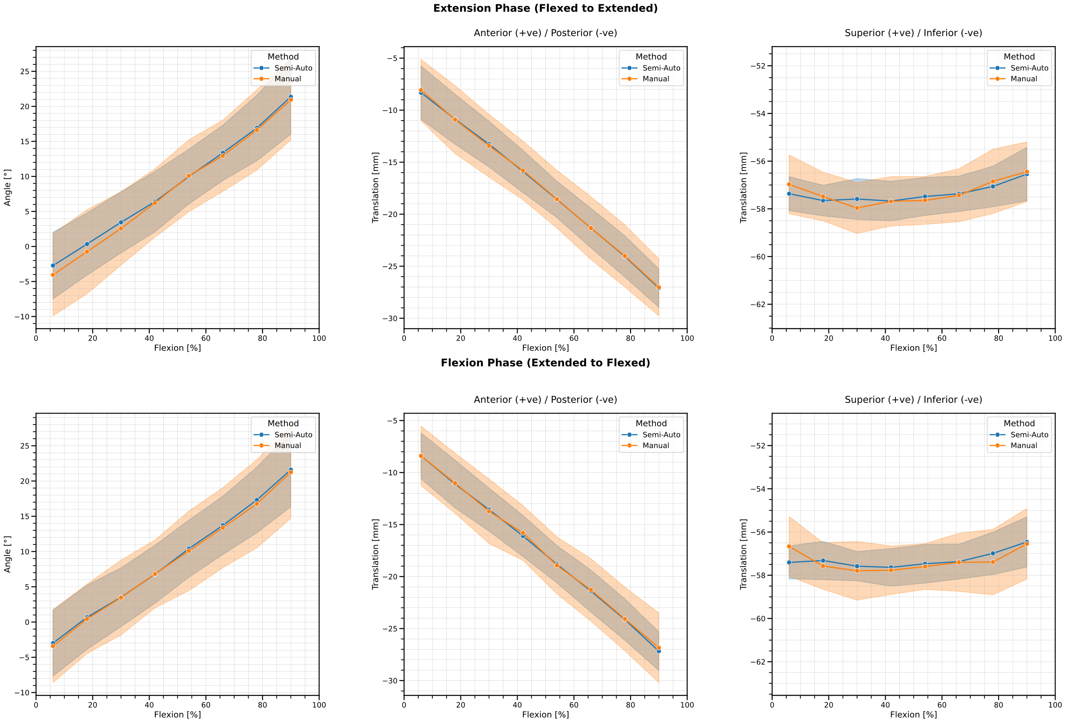
Supplementary materials
Jena | 25.10.2024 | Aayush Nepal

Slide 26
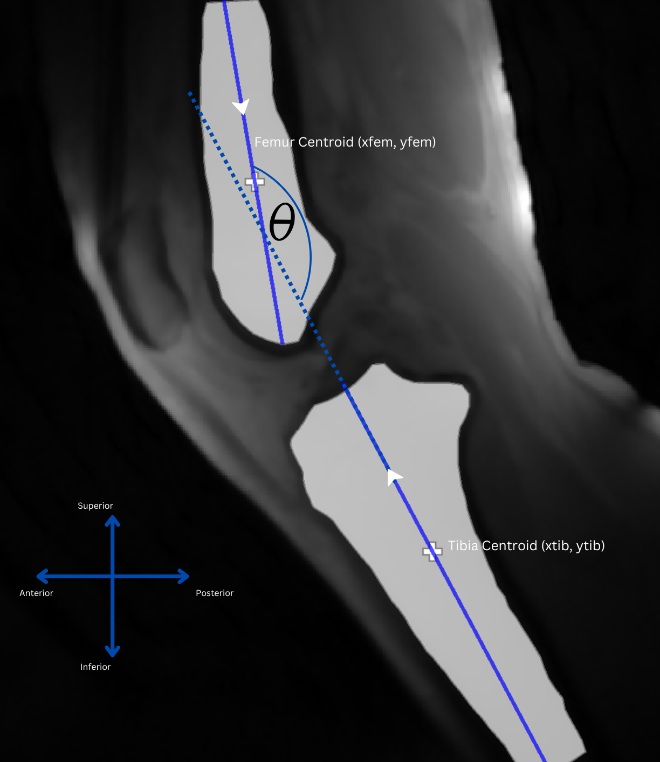
Supplementary materials
Jena | 25.10.2024 | Aayush Nepal

